Slide 1
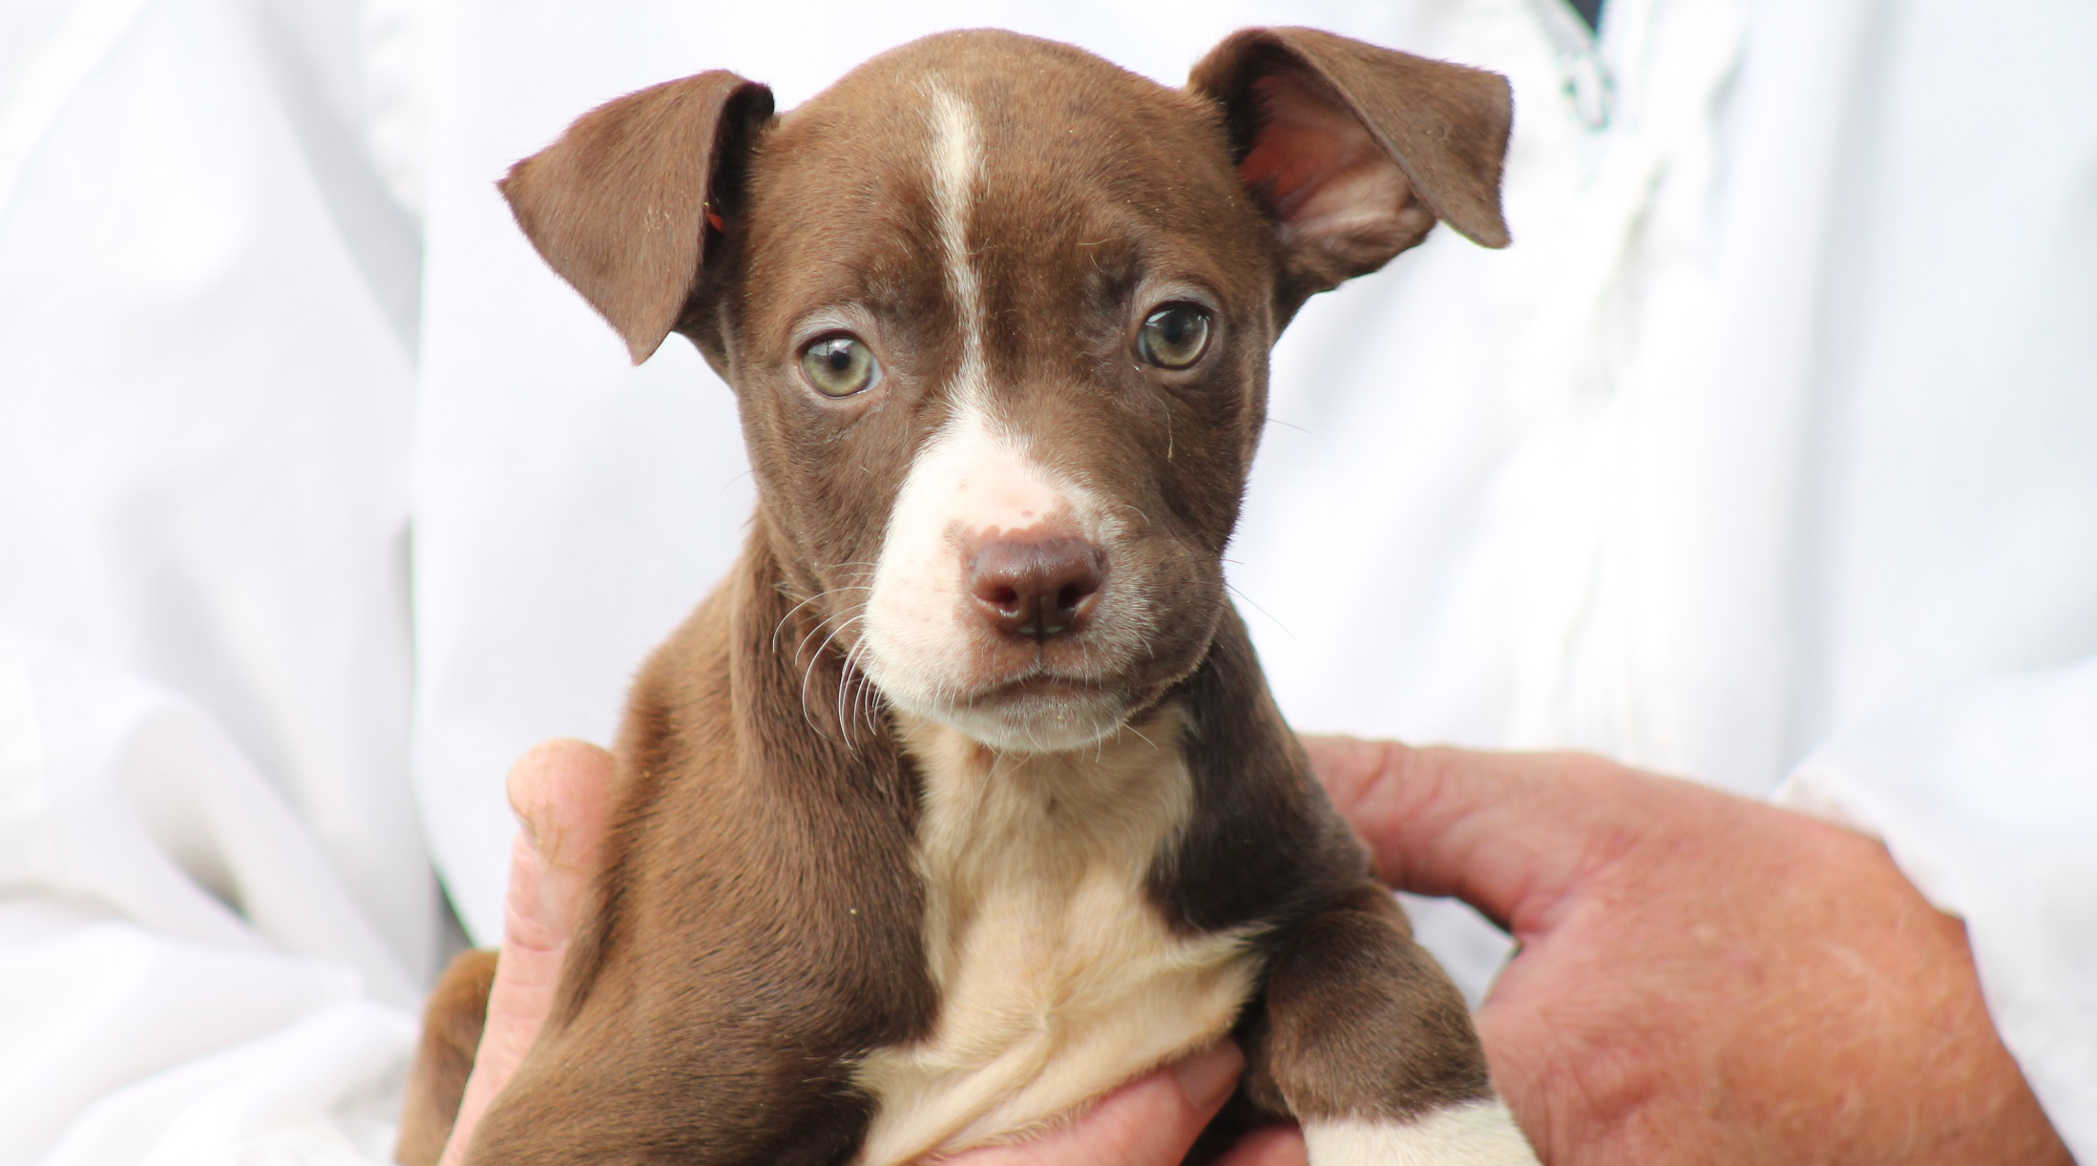

An introduction to

Slide 2
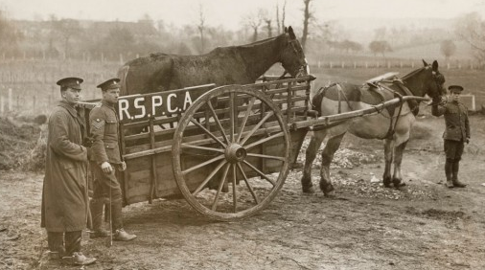
The beginning . . .

Slide 3
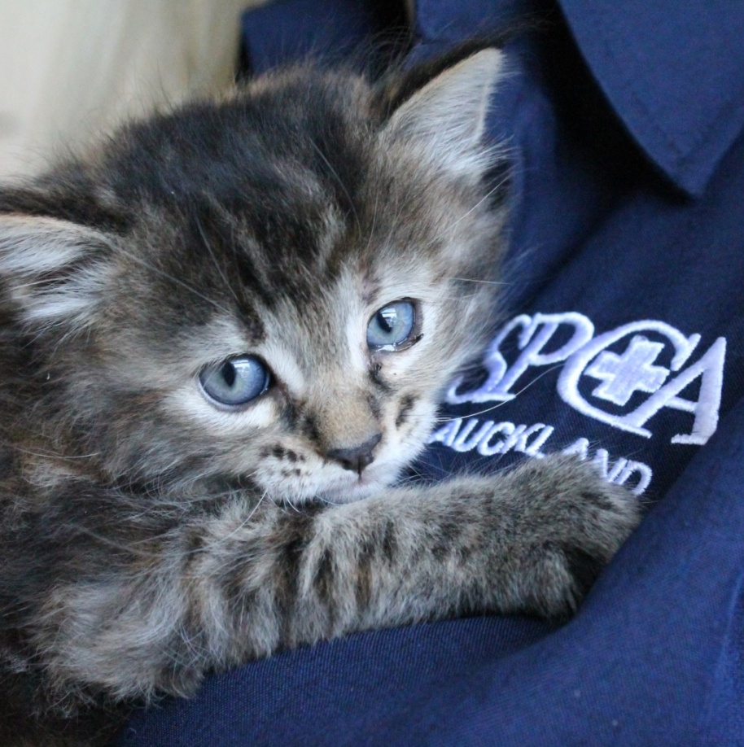
What do the letters S.P.C.A stand for?
Society for the
Prevention of
Cruelty to
Animals

Slide 4
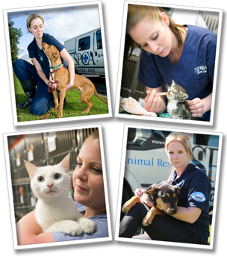
What is a society?
S P C A
The Oxford Dictionary defines a society as an organisation or club formed for a particular purpose or activity.

Slide 5

What does prevention mean?
S P C A
The Oxford Dictionary defines prevention as the action of stopping something from happening or arising.

Slide 6
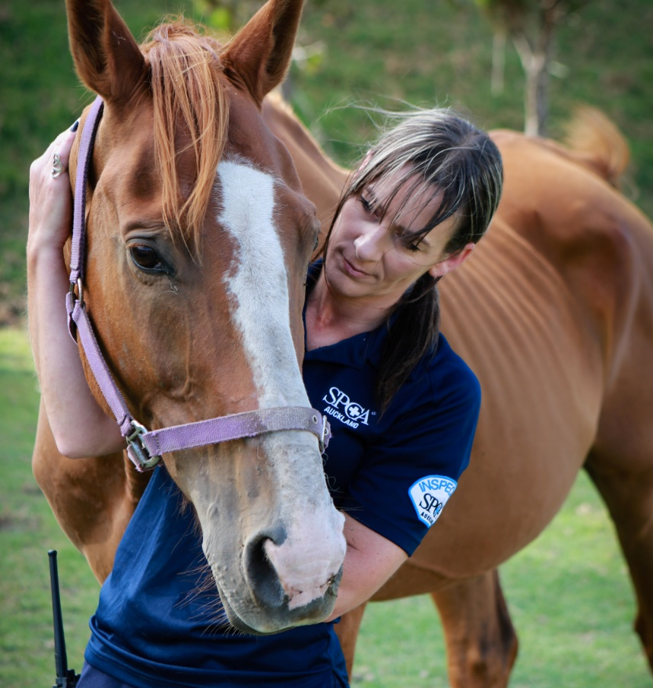
What is cruelty?
S P C A
The Oxford Dictionary defines cruelty as a behaviour that causes physical or mental harm, pain or suffering to a person or animal.

Slide 7
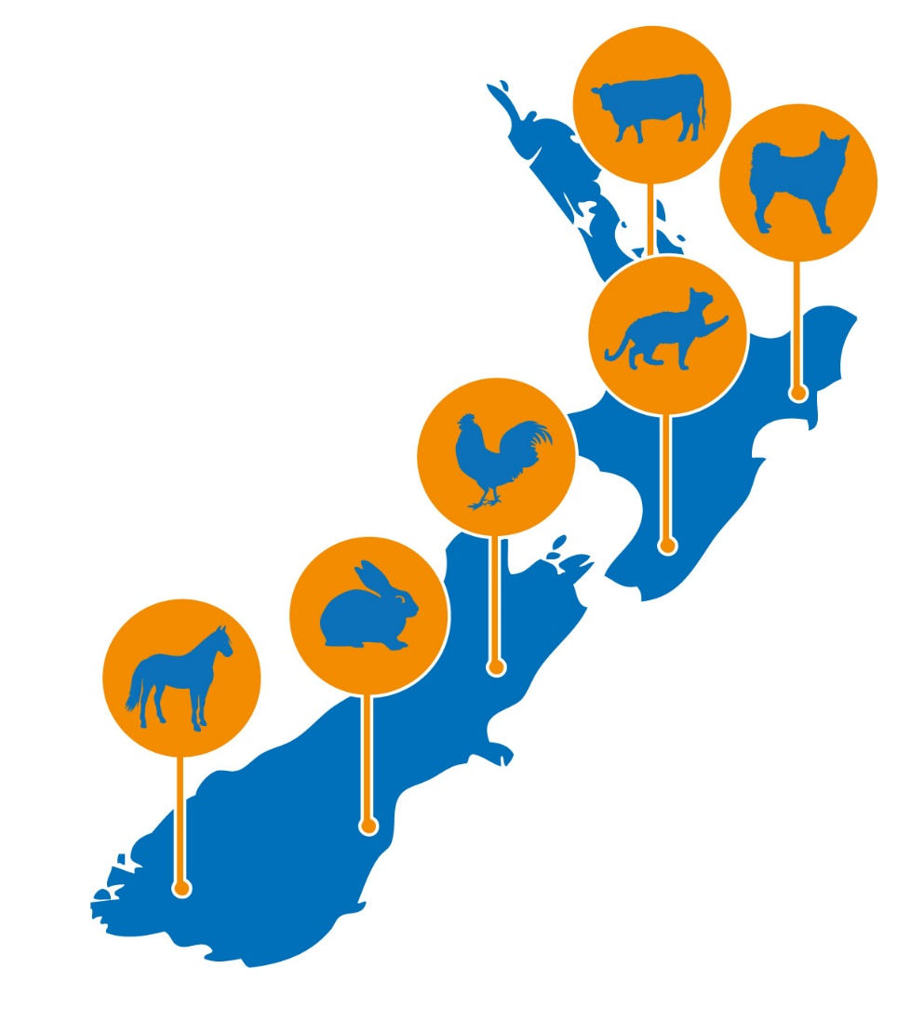
What animals?
S P C A
SPCA does everything it can to ensure all animals throughout New Zealand are being looked after.

Slide 8
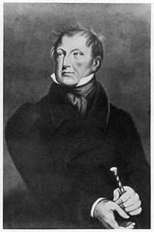
The world's first ever anti-cruelty law
Richard Martin,
an Irishman and Member of Parliament for Galway, introduced an animal protection Bill into Parliament in 1821.

Slide 9
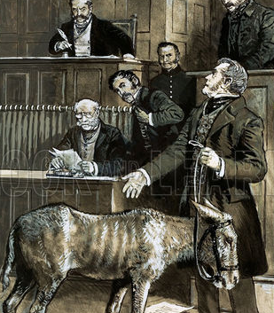
The world's first ever anti-cruelty law
Richard Martin’s animal protection bill was designed to outlaw cruelty to cattle, horses and sheep.

Slide 10
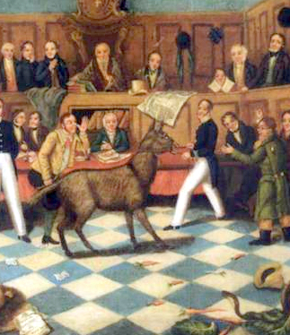
The world's first ever anti-cruelty law
Defeated at first, he made another attempt in 1822.
This time he received Parliamentary support and the Protection of Animals Act became the world's first ever anti-cruelty law in 1822.

Slide 11
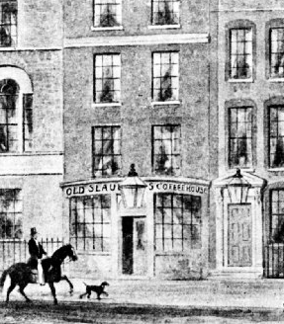
The world’s oldest animal welfare organisation
In 1824 at Old Slaughters Coffee House, in the City of Westminster, London the first SPCA was established.

Slide 12
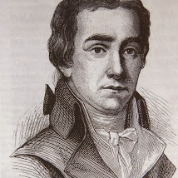
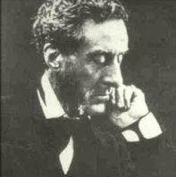
The world’s oldest animal welfare organisation
Reverend Arthur Broome called together the group, including:
Richard Martin
William Wilberforce
(well known for his bold stand against slavery)
Lord Shaftesbury

Slide 13
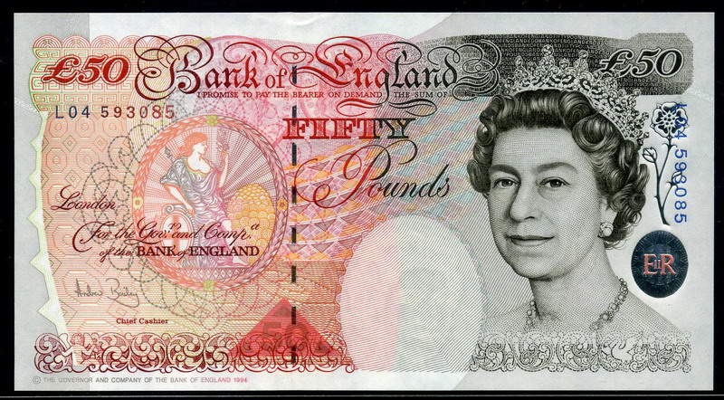
The world’s oldest animal welfare organisation
Broome sacrificed his London living to work full-time (unpaid) for the Society as its first Secretary.
The first recorded donation to the Society was 50 pounds sterling.

Slide 14
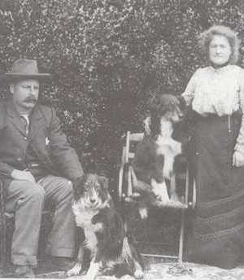
The SPCA in New Zealand
Early British settlers brought with them a number of English laws, amongst them the Protection of Animals Act.
This Act was replaced in 1878 by the first New Zealand Act protecting animals - by then the settlers had time to think of other things besides establishing the necessities of life.
In 1872 SPCA Canterbury was formed. This was quickly followed in the other main centres, Otago in 1882, Auckland in 1884, and Wellington 1885. Gradually smaller communities established their own SPCAs. Today there are around 45 SPCAs throughout New Zealand.

Slide 15
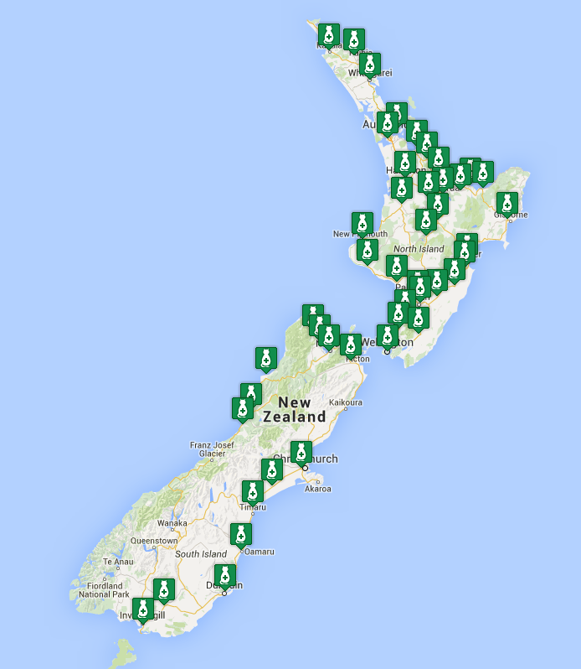
The SPCA in New Zealand
There are now 46 SPCA Centres across New Zealand, providing help to animals and owners 24 hours a day, seven days a week.

Slide 16
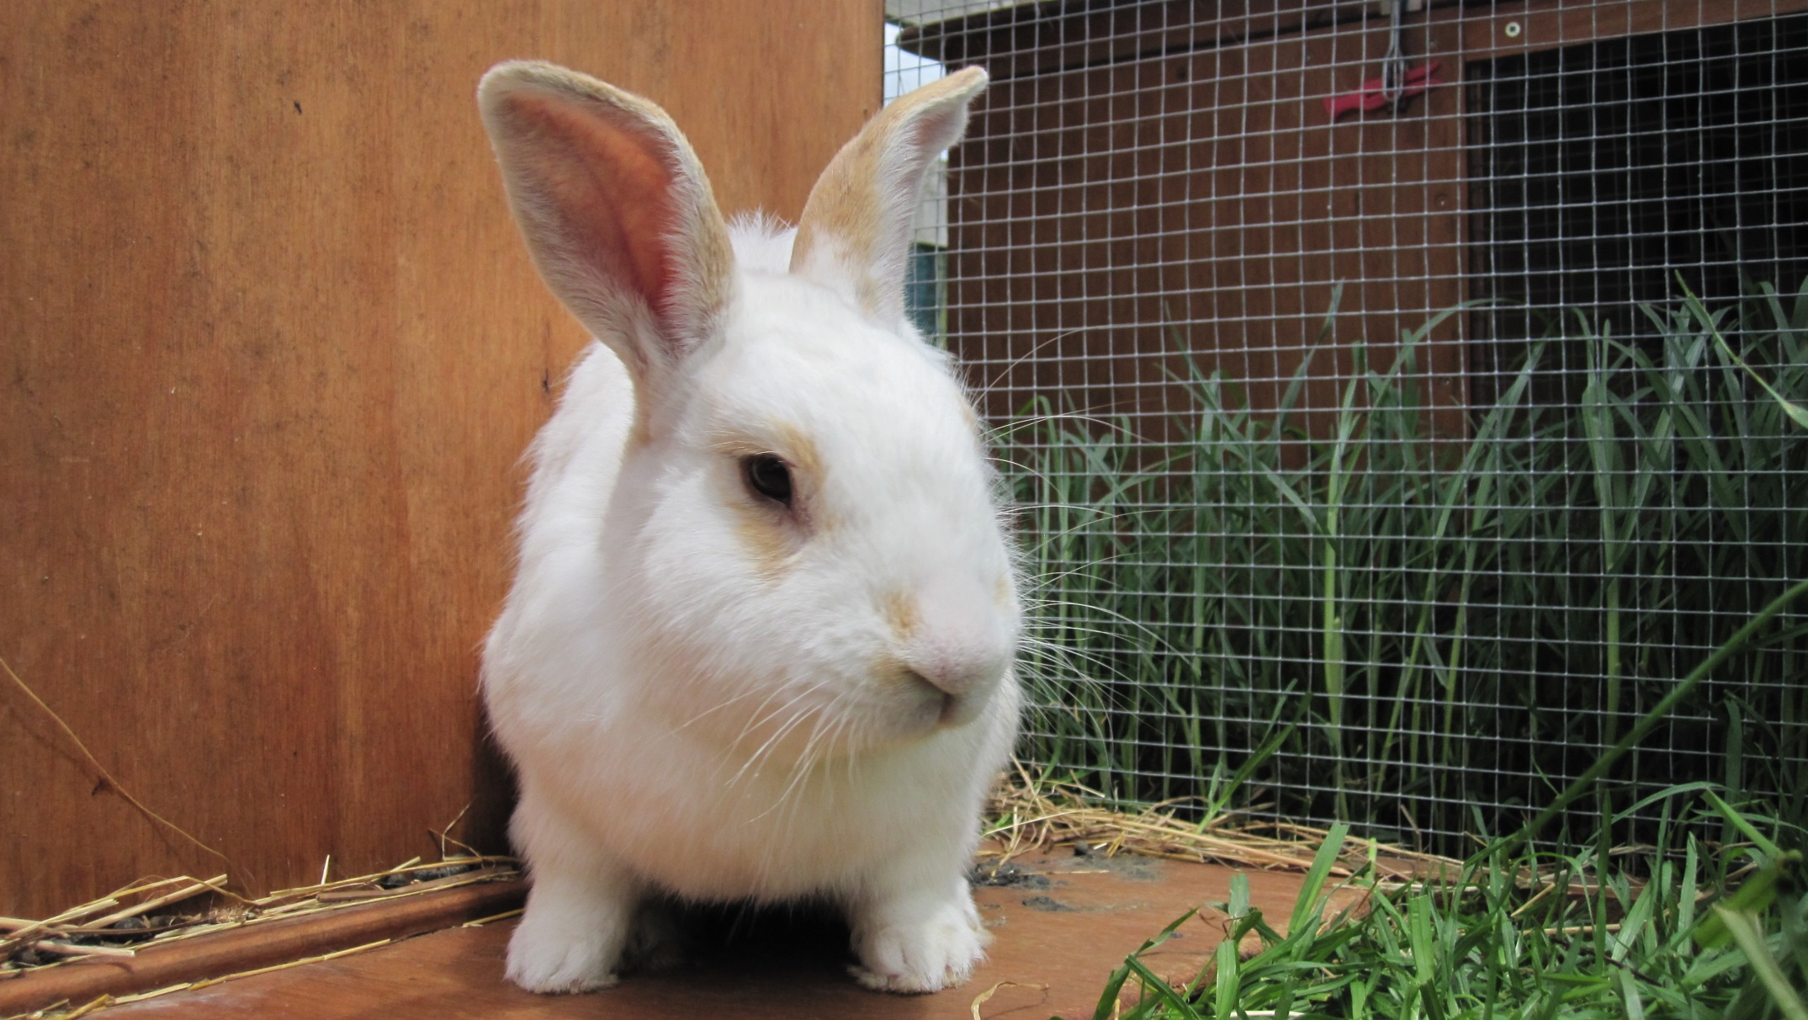
What we do . . .

Slide 17
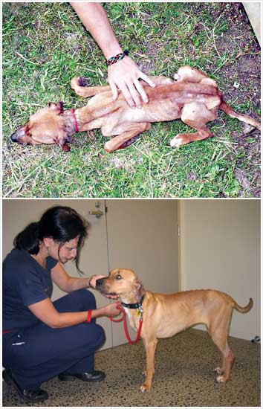
Encourage the humane treatment of all animals and prevent cruelty being inflicted upon them
SPCA educates and encourages better treatment of animals
SPCA provides shelter, care and a fresh start for sick, injured and unwanted animals
SPCA enforces The Animal Welfare Act 1999 to protect animals

Slide 18
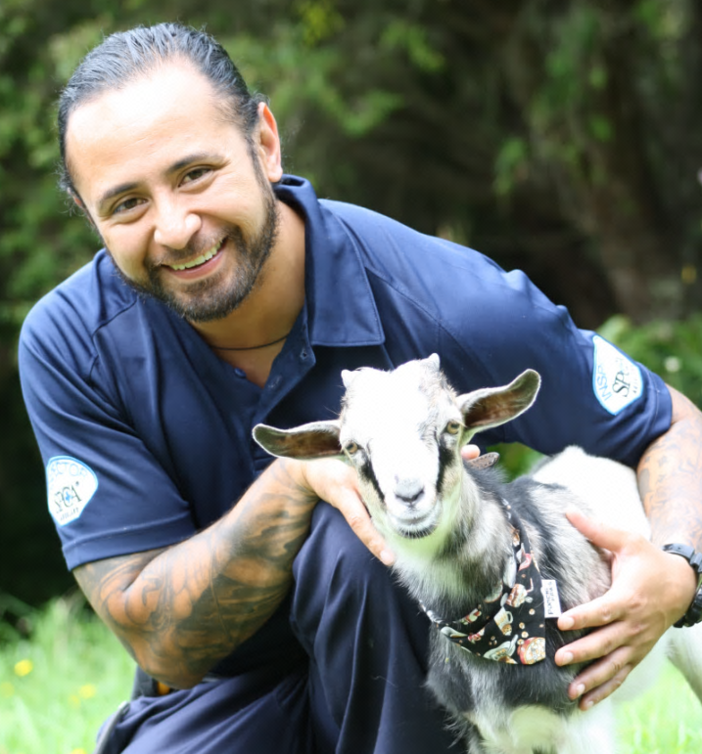
Encourage the humane treatment of all animals and prevent cruelty being inflicted upon them
SPCA rescues thousands of animals every year from harmful situations, attends dozens of animal emergencies, and investigates thousands of complaints about animal cruelty.

Slide 19
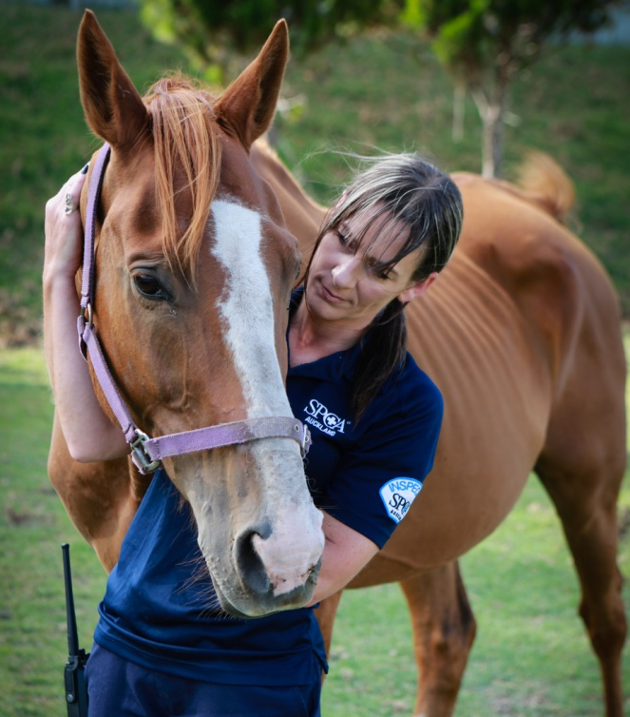
Why do animals come to the SPCA?
Sick
Abandoned
Injured
Lost
People were cruel to them
They no longer have a home

Slide 20
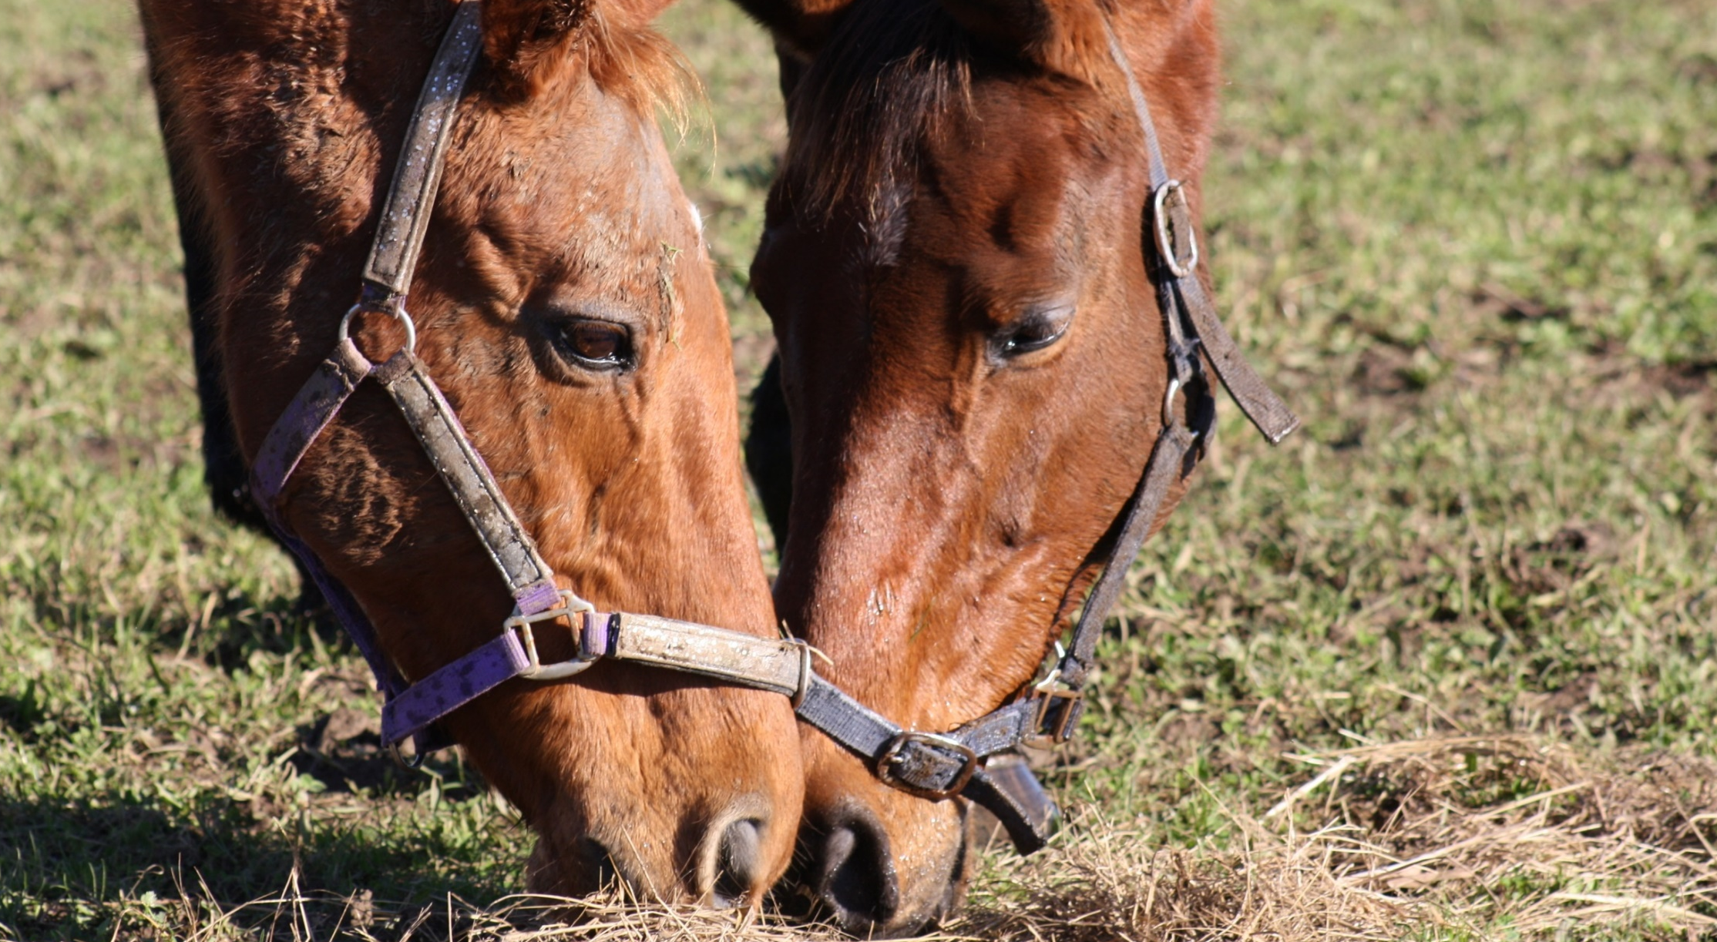
What happens when an animal arrives . . .

Slide 21
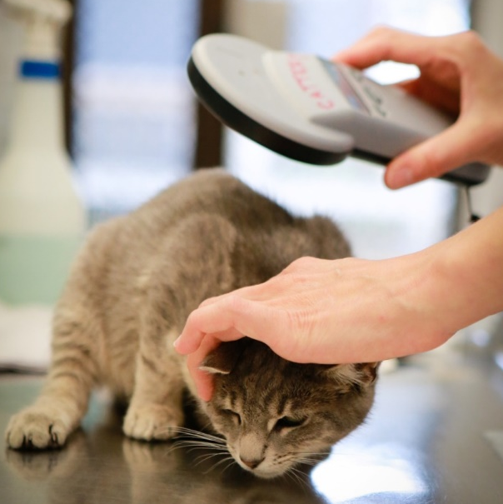
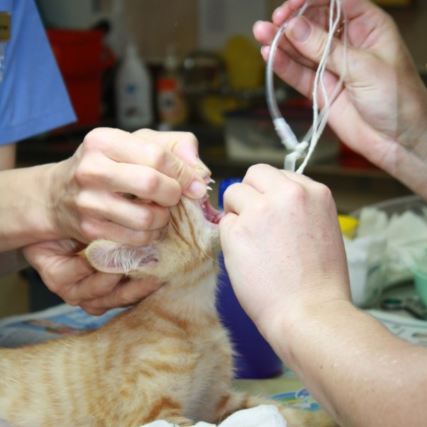
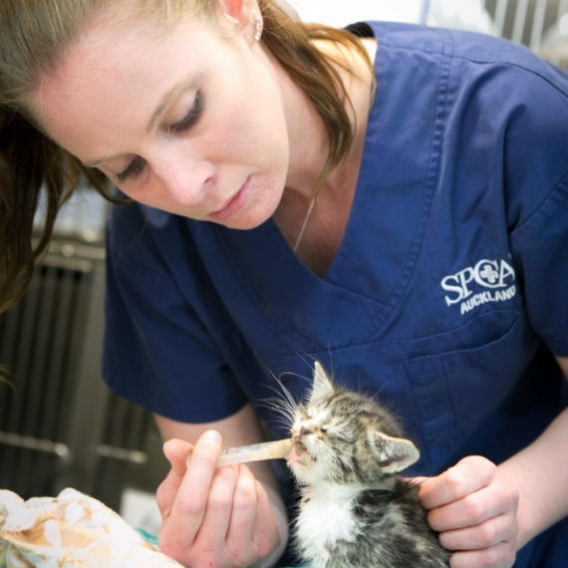
SPCA Animal Incoming Process
Hospital
Scanned for a microchip
Checked by a vet
Medical care is given if it is needed

Slide 22
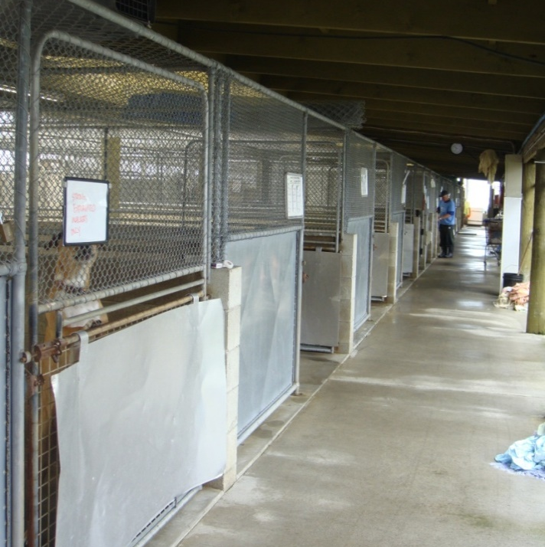
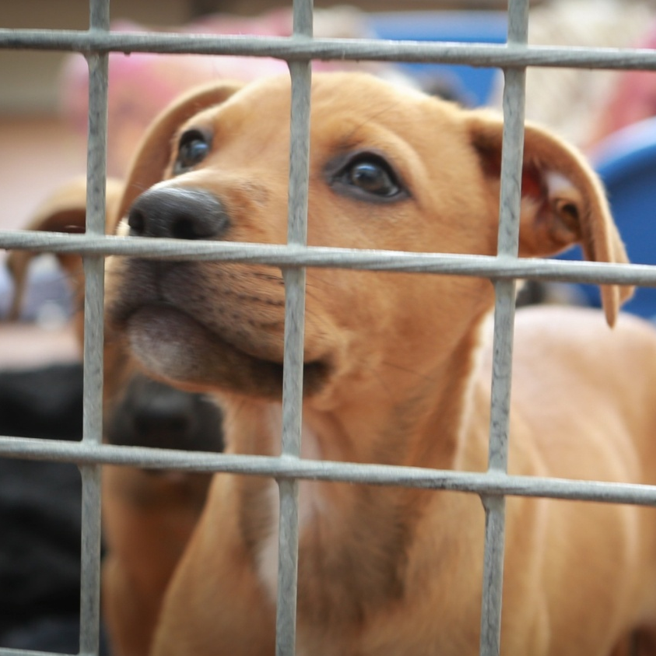
SPCA Animal Incoming Process
Holding time
Stray time
Quarantine

Slide 23
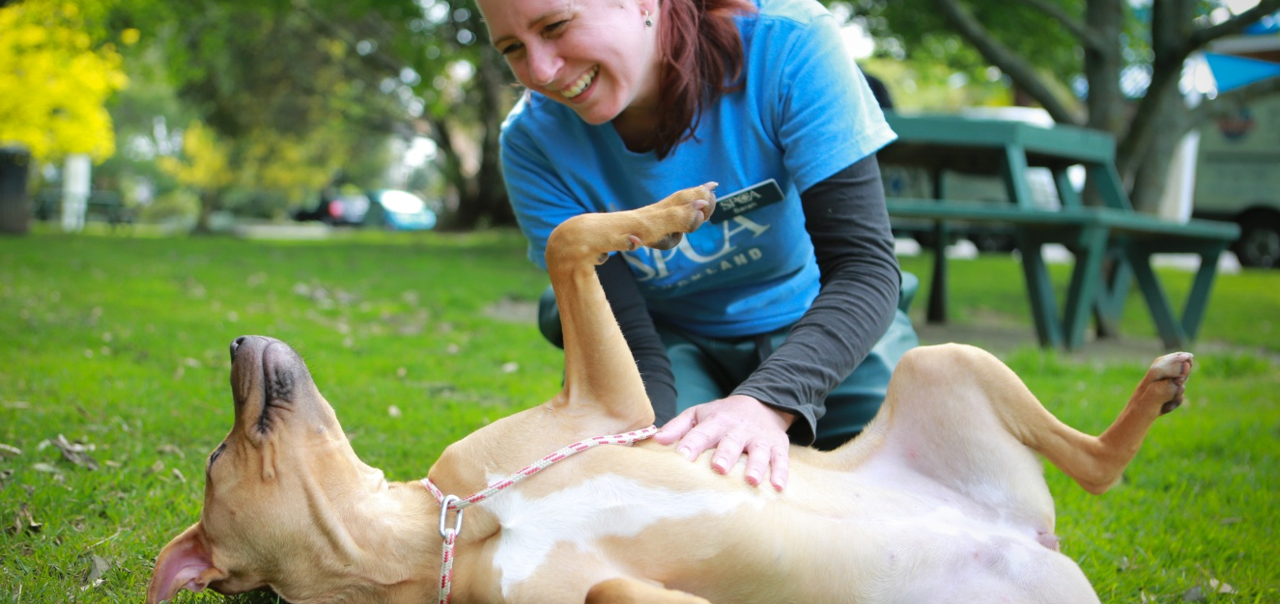
SPCA Animal Incoming Process
Care
Onsite or at a foster home

Slide 24
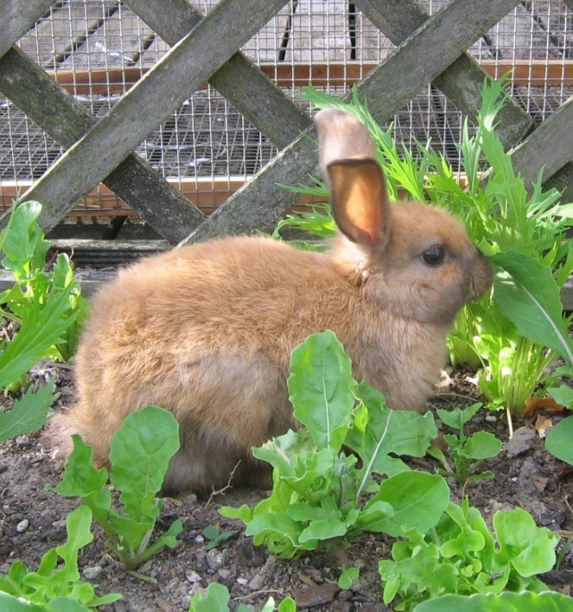
SPCA Animal Incoming Process
What is a foster home?
Many animals that come into the SPCA Animal Villages need a little extra TLC before finding their new forever home.
They may be recovering from surgery or illness, or simply put on a little more weight before being spayed or neutered.
Foster Parents provide a temporary home for these animals.

Slide 25
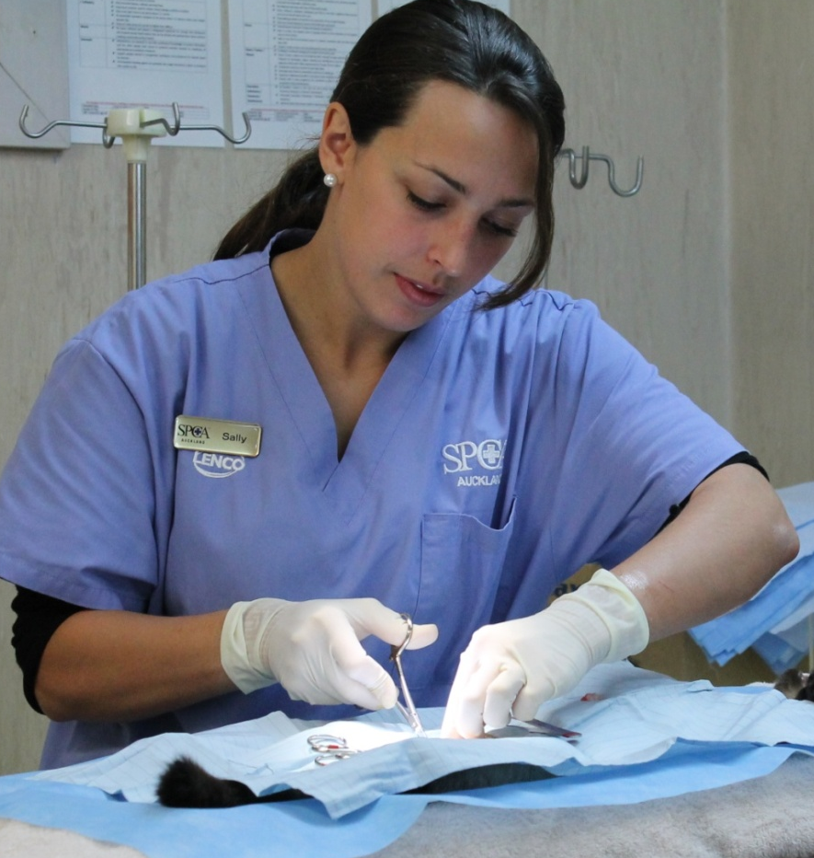
SPCA Animal Incoming Process
Spay and Neuter
There are too many pets in NZ and not enough homes.
There are only so many homes for pets in NZ and sadly there are far too many pets and just not enough homes.
Every puppy or kitten you allow your pet to breed, steals a place and the chance of life from a pet already waiting.

Slide 26
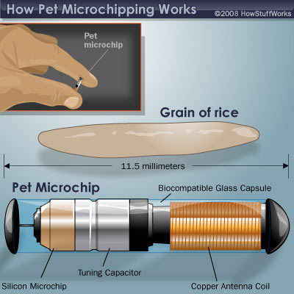
SPCA Animal Incoming Process
Microchipping
A needle is inserted under the skin at the scruff of the neck, the microchip itself enters under the skin through the middle of the needle.
All microchips carry a unique code which identifies your pet. The number is found by using a scanner; the number is then put into the computer on a national microchip database.

Slide 27
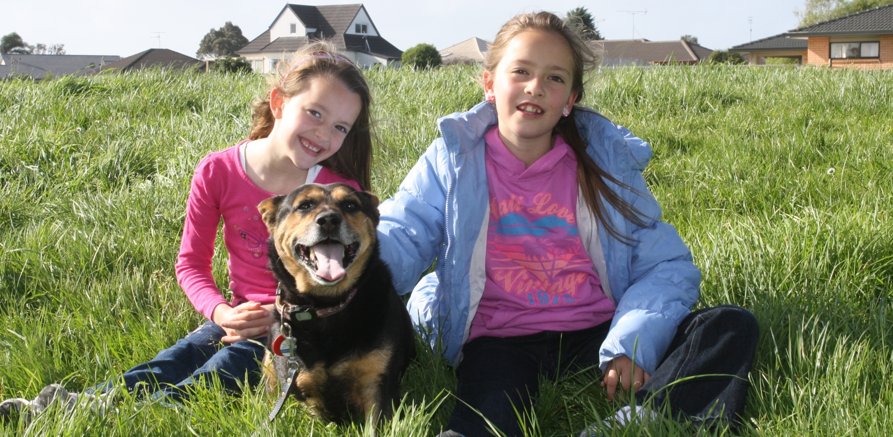
SPCA Animal Incoming Process
Finding a forever home

Slide 28
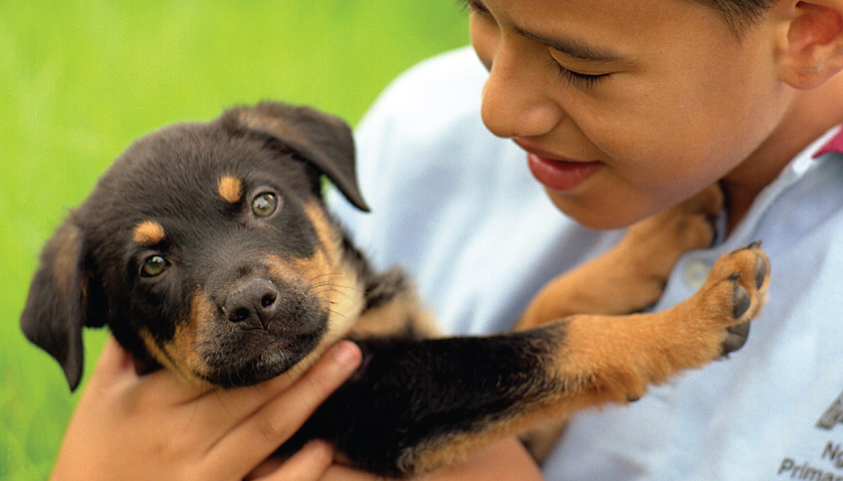
A charity organisation

Slide 29

What is the definition of a charity?
An organization set up to provide help and raise money for those in need.
The voluntary giving of help, typically in the form of money, to those in need.

Slide 30
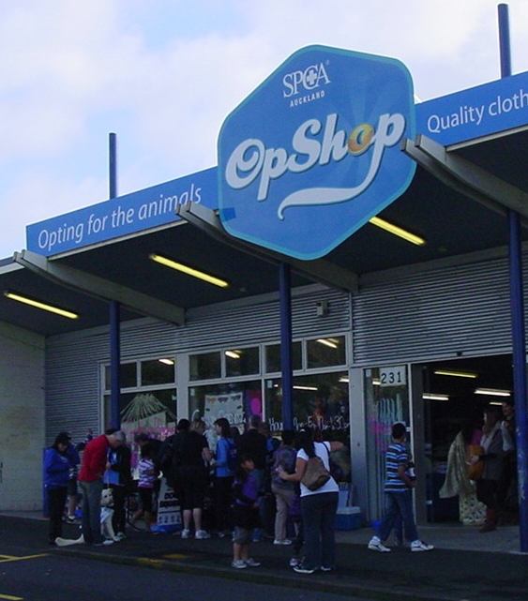
How can the SPCA afford to help so many animals?
We receive no direct government funding so we rely on:
Volunteers
SPCA Op Shops
Donations
Fundraisers
Sponsorship

Slide 31
Ways you can support your local SPCA
Spread the word - help us educate people about important animal welfare issues
Fundraise for us
Attend SPCA events
Support SPCA campaigns like - Cupcake Day and the Annual Appeal
Collect and donate items such as old towels, blankets, pet food
Donate items for SPCA Op shops
Ask your family to become a foster home
Become a volunteer when you turn 18

Slide 32
